Slide 1

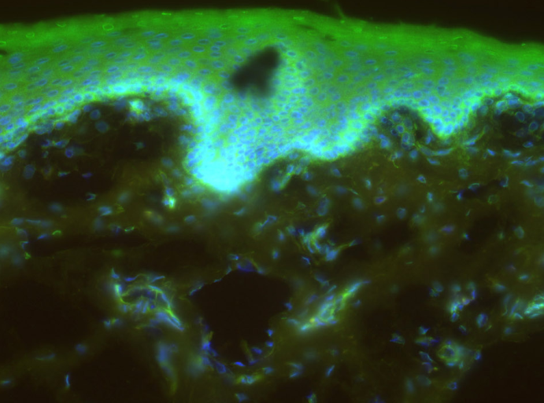
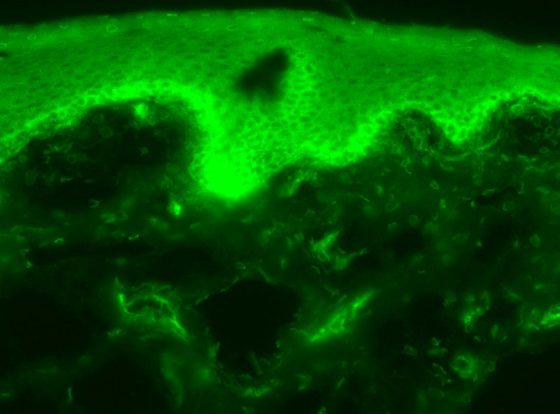
ReliaTech GmbH
Rabbit anti-human MesP1
(Cat #102-PA52)
Immunofluorescence staining of cryo-sections of unfixed human foreskin with anti-human MesP1 (dilution 1:100) [Cat# 102-PA52] and counter staining of nuclei with Dapi.
Note: The specific green MesP1 signal is visible in the epidermis and in dermal blood vessels.
The experiment was performed by the research group of Prof. Dr. J. Wilting and Dr. K. Buttler, University Medicine Göttingen, Germany.
http://www.reliatech.de / orders@reliatech.de

